Slide 1
Memory management. Garbage collector
By Yuliia Tsurkan

Slide 2
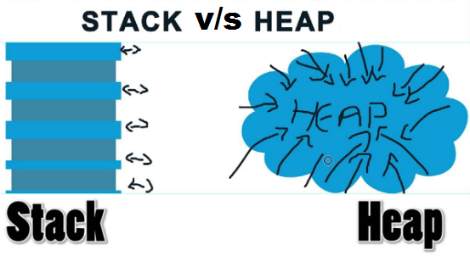

Slide 3
Value-types and Reference-types
Stack: A memory area that is used sequentially when calling functions, storing value types and a heap reference for reference values.
Heap: Memory is allocated and released inconsistently and as needed.
Value-types are stored in scope completely and for reference-types only reference to their location is put in scope. They themselves are located in place called "memory heap".
String and all Objects are reference-types. Other data types are stored in scope.

Slide 4
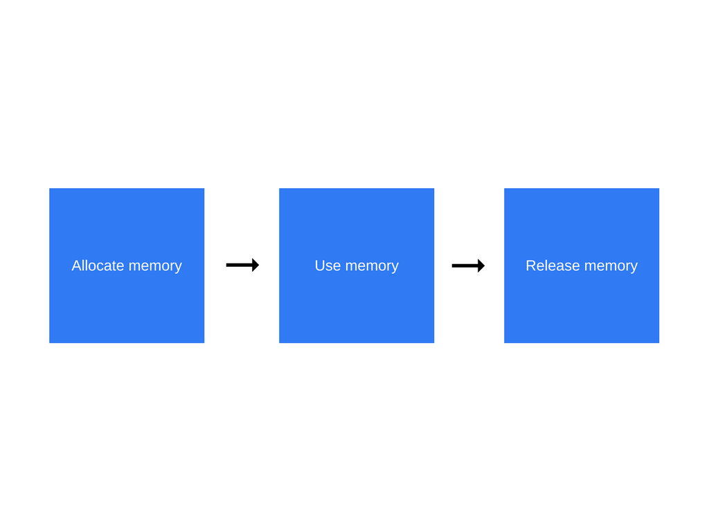
Memory life cycle

Slide 5
Manual Vs. Automatic
Manual control: every time we create an object in a heap, we have to delete it when it becomes unnecessary.
Automatic : no need to explicitly delete an object, just stop using it, garbage collector will do it itself when there are no active links to it.
Manual
C++
C
Automatic
Python
Java
JavaScript
C#
Pascal
Assembler

Slide 6
Garbage collector
Garbage collector is responsible for the cleanup of unreachable objects.
It's a special utility that will launch automatically if there isn’t enough space in the sandbox.
If an object has at least one reference it is still reachable and will survive after memory cleaning.

Slide 7
Garbage collection algorithms
Mark-and-sweep algorithm
Reference-counting

Slide 8
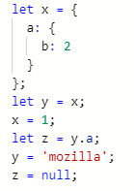
Reference-counting garbage collection
This algorithm reduces the problem from determining whether or not an object is still needed to determining if an object still has any other objects referencing it. An object is said to be "garbage", or collectible if there are zero references pointing to it.

Slide 9
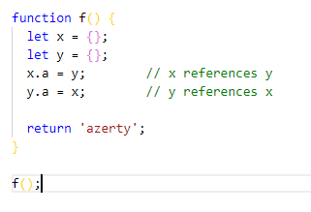
Limitation: Circular references

Slide 10
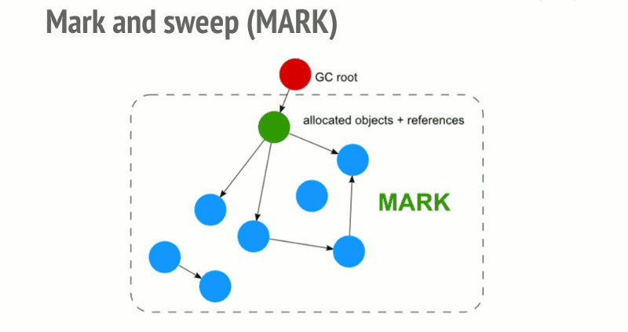
Mark-and-sweep algorithm

Slide 11


